Slide 1


Logistics Integrated Management System
Data Cleaning, Database Design & Operational Insights
Preparation : Hassan Ali Hassan

Slide 2
Logistics Integrated Management System
Data Cleaning, Database Design & Operational Insights
Preparation : Hassan Ali Hassan

Slide 3
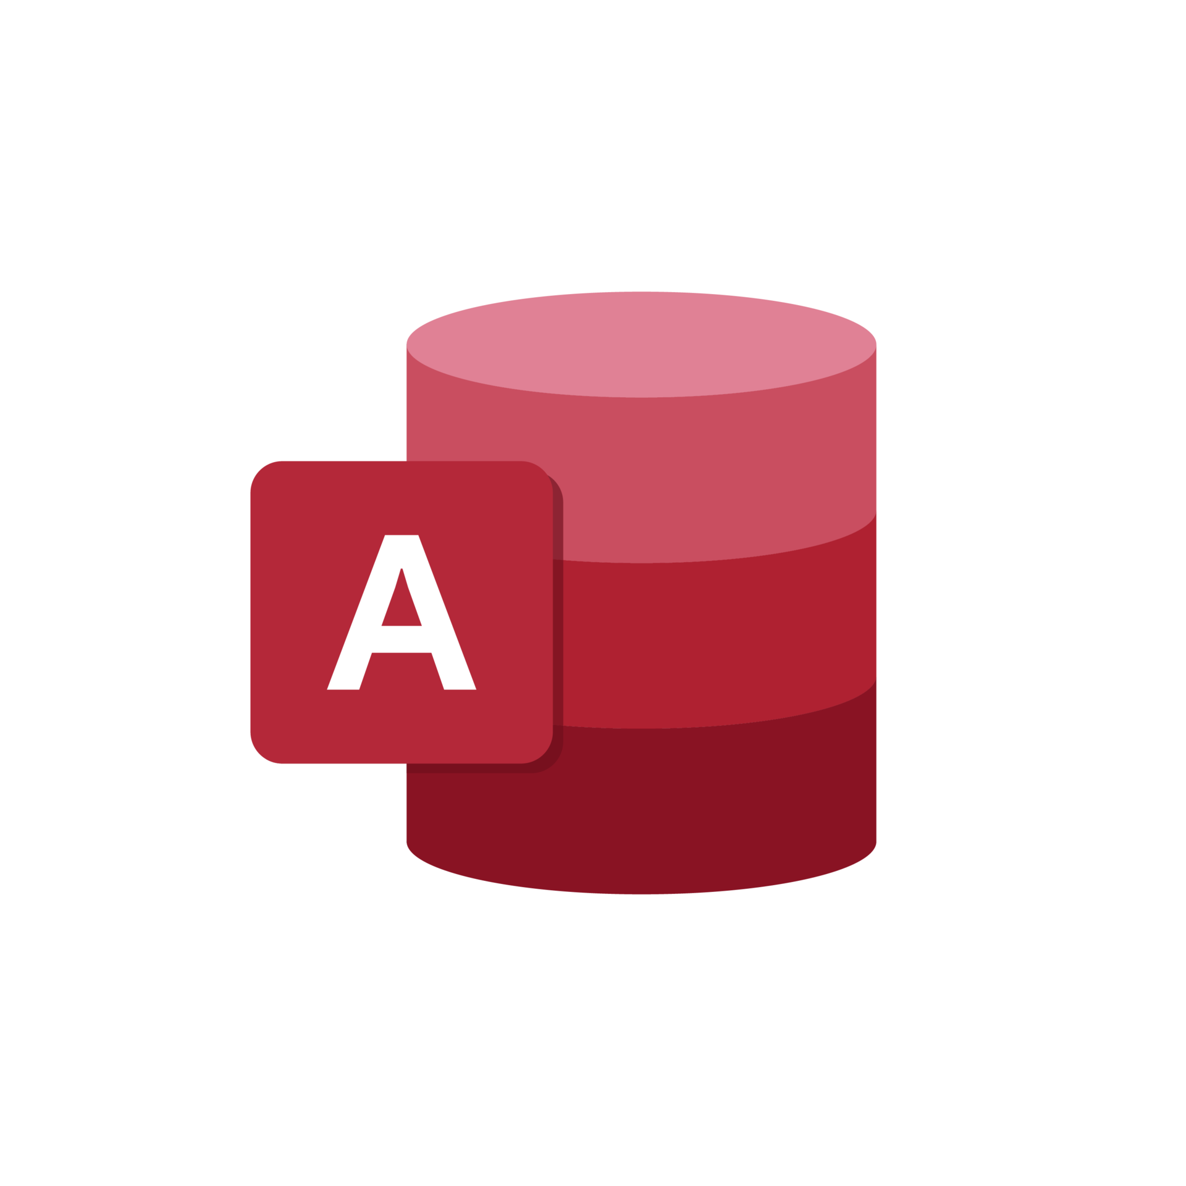


Data Cleaning, Database Design & Operational Insights
Database Normalization: تقسيم البيانات لـ 4 جداول مترابطة.
Relational Integrity: بناء علاقات تمنع تكرار البيانات
Automated Reporting:استعلام لحساب الضرائب والتقارير المالية
Data Cleaning: معالجة البيانات الخام وإزالة الأخطاء.
Feature Engineering: لحساب كل شحنة
Visual Analysis: بناء 9 رسومات بيانية.

Slide 4
Data Cleaning, Database Design & Operational Insights
Database Normalization: تقسيم البيانات لـ 4 جداول مترابطة.
Relational Integrity: بناء علاقات تمنع تكرار البيانات
Automated Reporting:استعلام لحساب الضرائب والتقارير المالية
Data Cleaning: معالجة البيانات الخام وإزالة الأخطاء.
Feature Engineering: لحساب كل شحنة
Visual Analysis: بناء 9 رسومات بيانية.

Slide 5
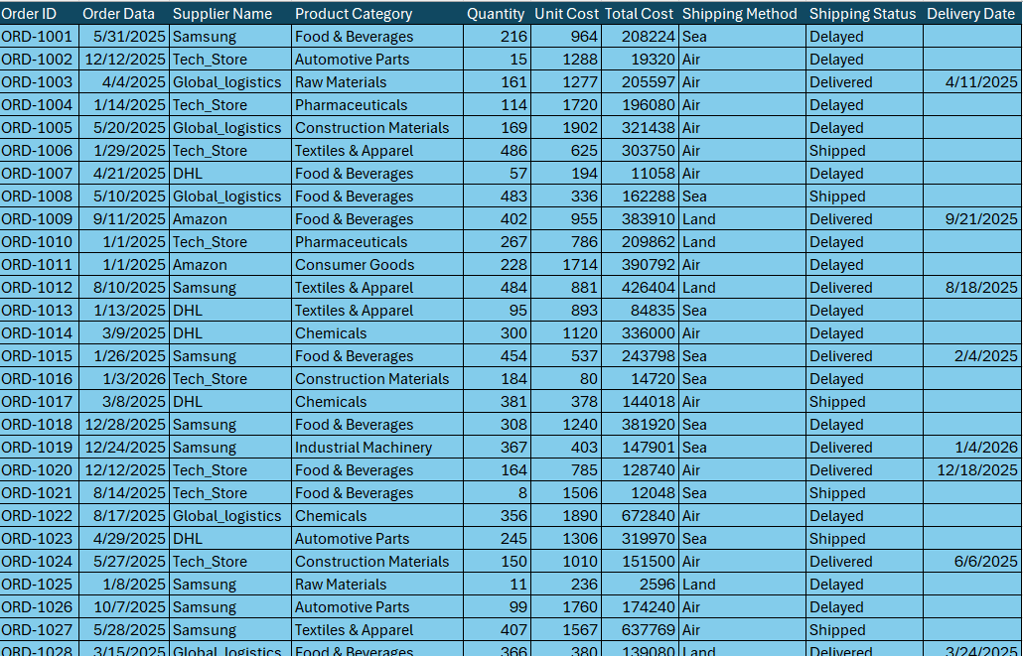


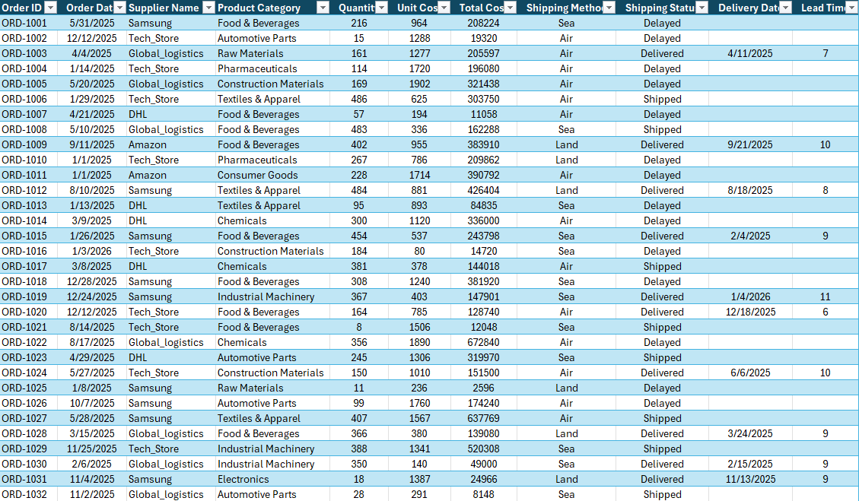

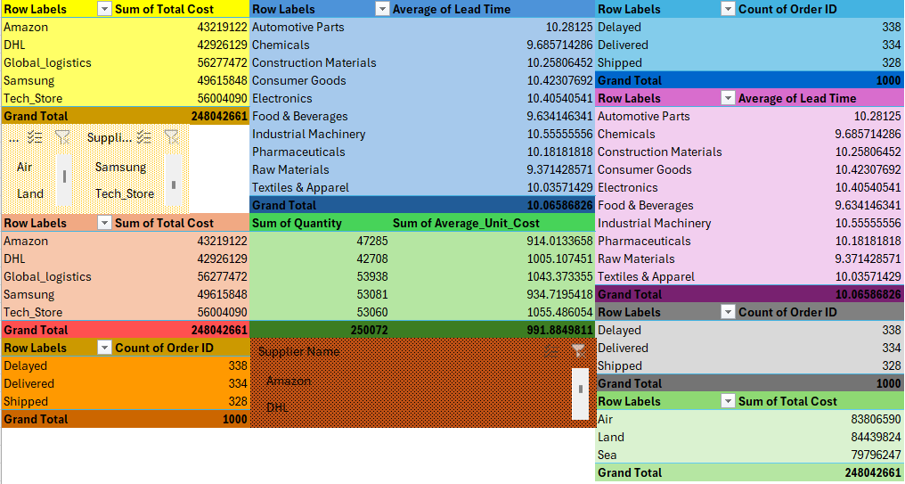
Data Cleaning & Feature Engineering (Excel)
Data Sanitization: Removing duplicates and handling missing delivery dates.
Lead Time Calculation: Creating a new metric [Delivery Date - Order Date] to measure shipping efficiency.
Data Validation: Ensuring all fields (Cost, Quantity, Status) are formatted correctly for database migration.
Standardization: Unifying Supplier and Product names to prevent errors during the "Normalization" phase.
Raw data
Cleaned data
Analysis

Slide 6
Data Cleaning & Feature Engineering (Excel)
Data Sanitization: Removing duplicates and handling missing delivery dates.
Lead Time Calculation: Creating a new metric [Delivery Date - Order Date] to measure shipping efficiency.
Data Validation: Ensuring all fields (Cost, Quantity, Status) are formatted correctly for database migration.
Standardization: Unifying Supplier and Product names to prevent errors during the "Normalization" phase.
Raw data
Cleaned data
Analysis

Slide 7
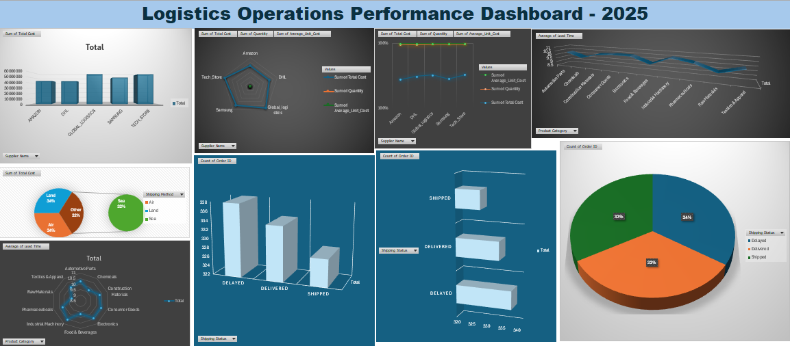
Dashboard

Slide 8

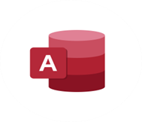
Tables Created:
Fact Table: Cleaned _ Data (Main transactions).
Dimension Tables: tbl _ Suppliers , tbl Products , and tbl _ Shipping _ Methods.
Relational Integrity: Establishing 1:M (One-to-Many) relationships to ensure data consistency across the system.
Relational Database Design
(MS Access)
Star Schema Architecture: Implementing a Fact-Dimension model for better data management.
Data Normalization: Converting the flat Excel sheet into a structured Relational Database to eliminate data redundancy.

Slide 9
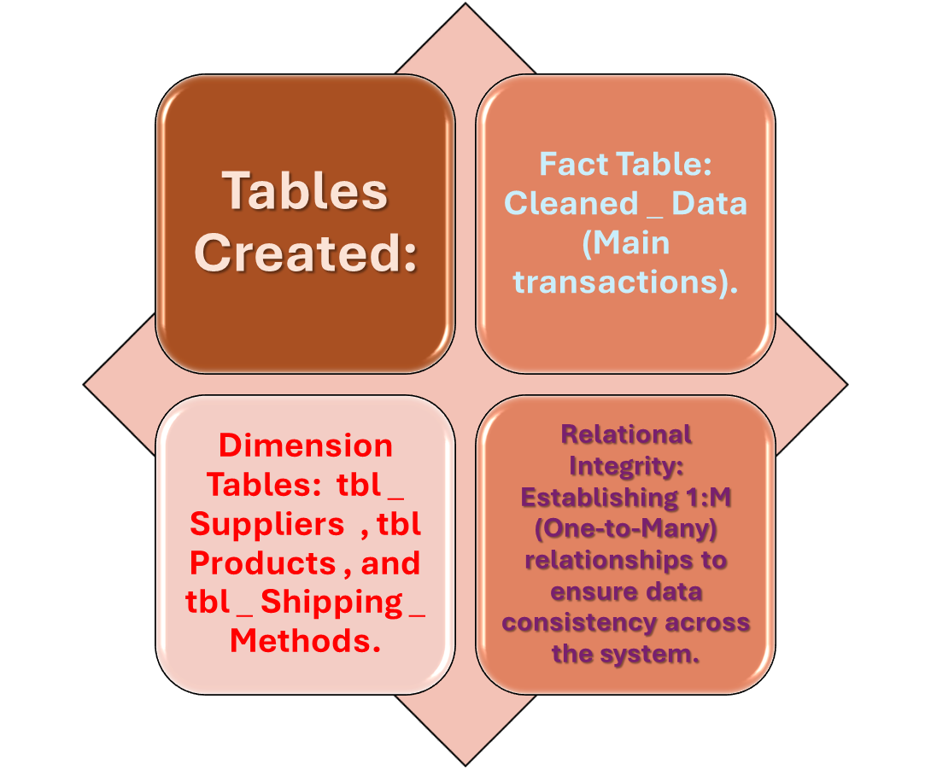
Relational Database Design
(MS Access)
Star Schema Architecture: Implementing a Fact-Dimension model for better data management.
Data Normalization: Converting the flat Excel sheet into a structured Relational Database to eliminate data redundancy.

Slide 10
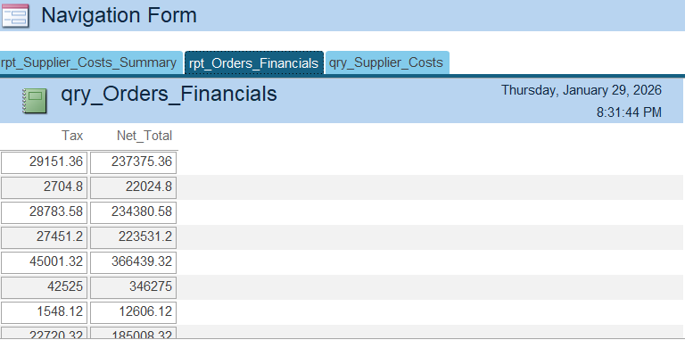

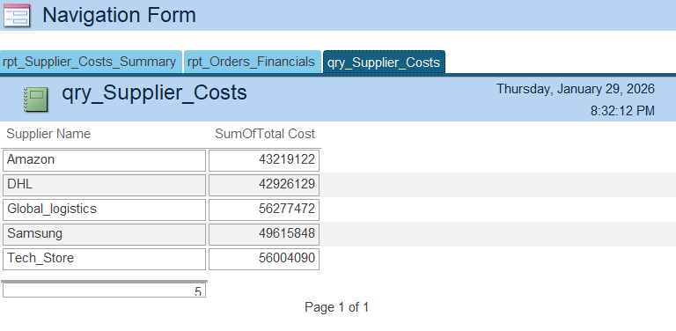

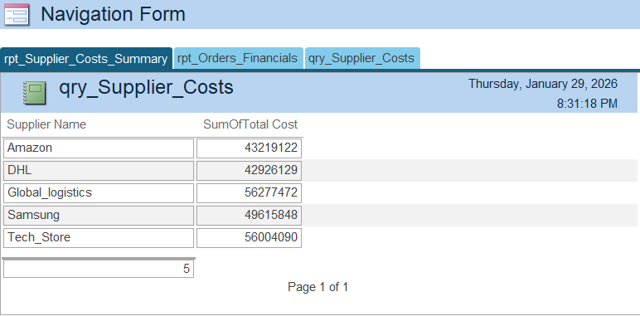

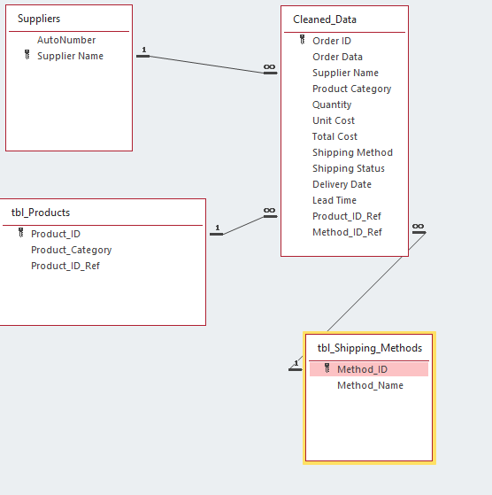
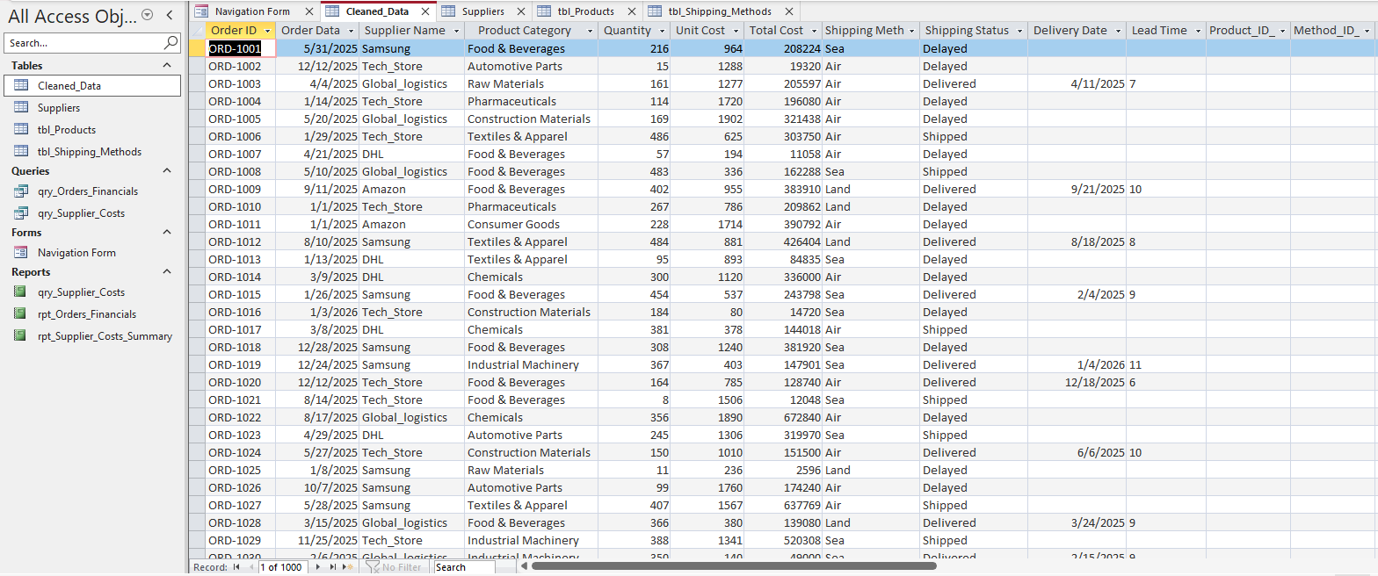




Database Architecture
Relational

Slide 11
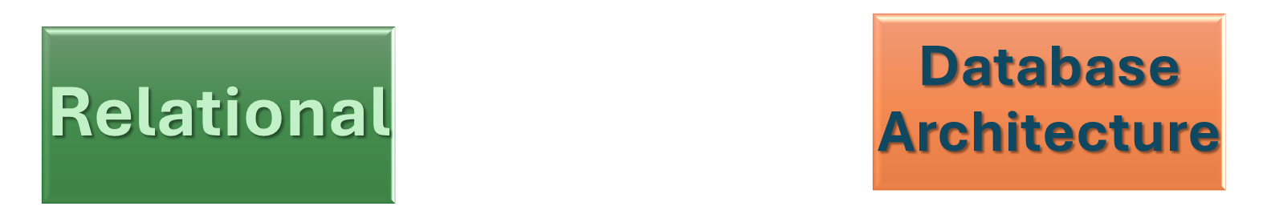

Slide 12

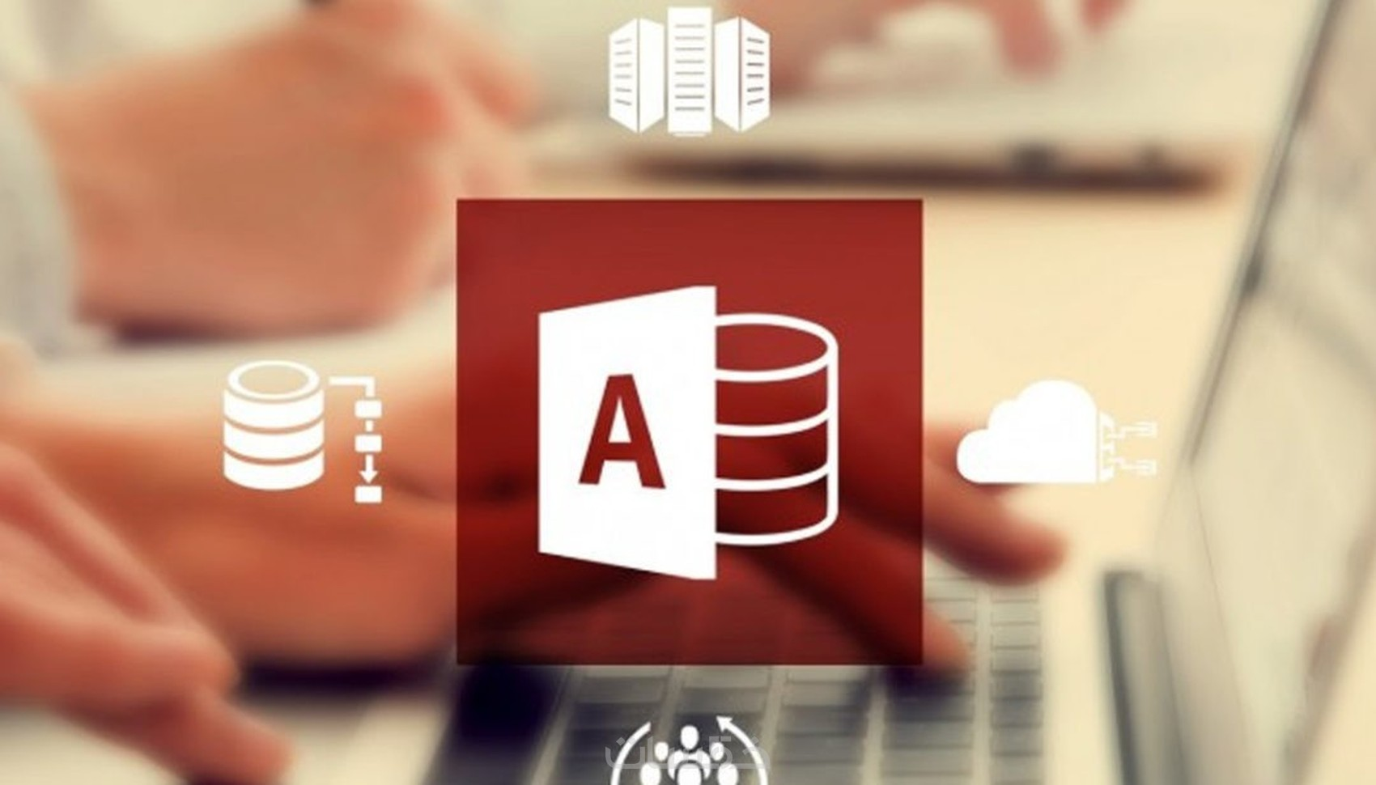
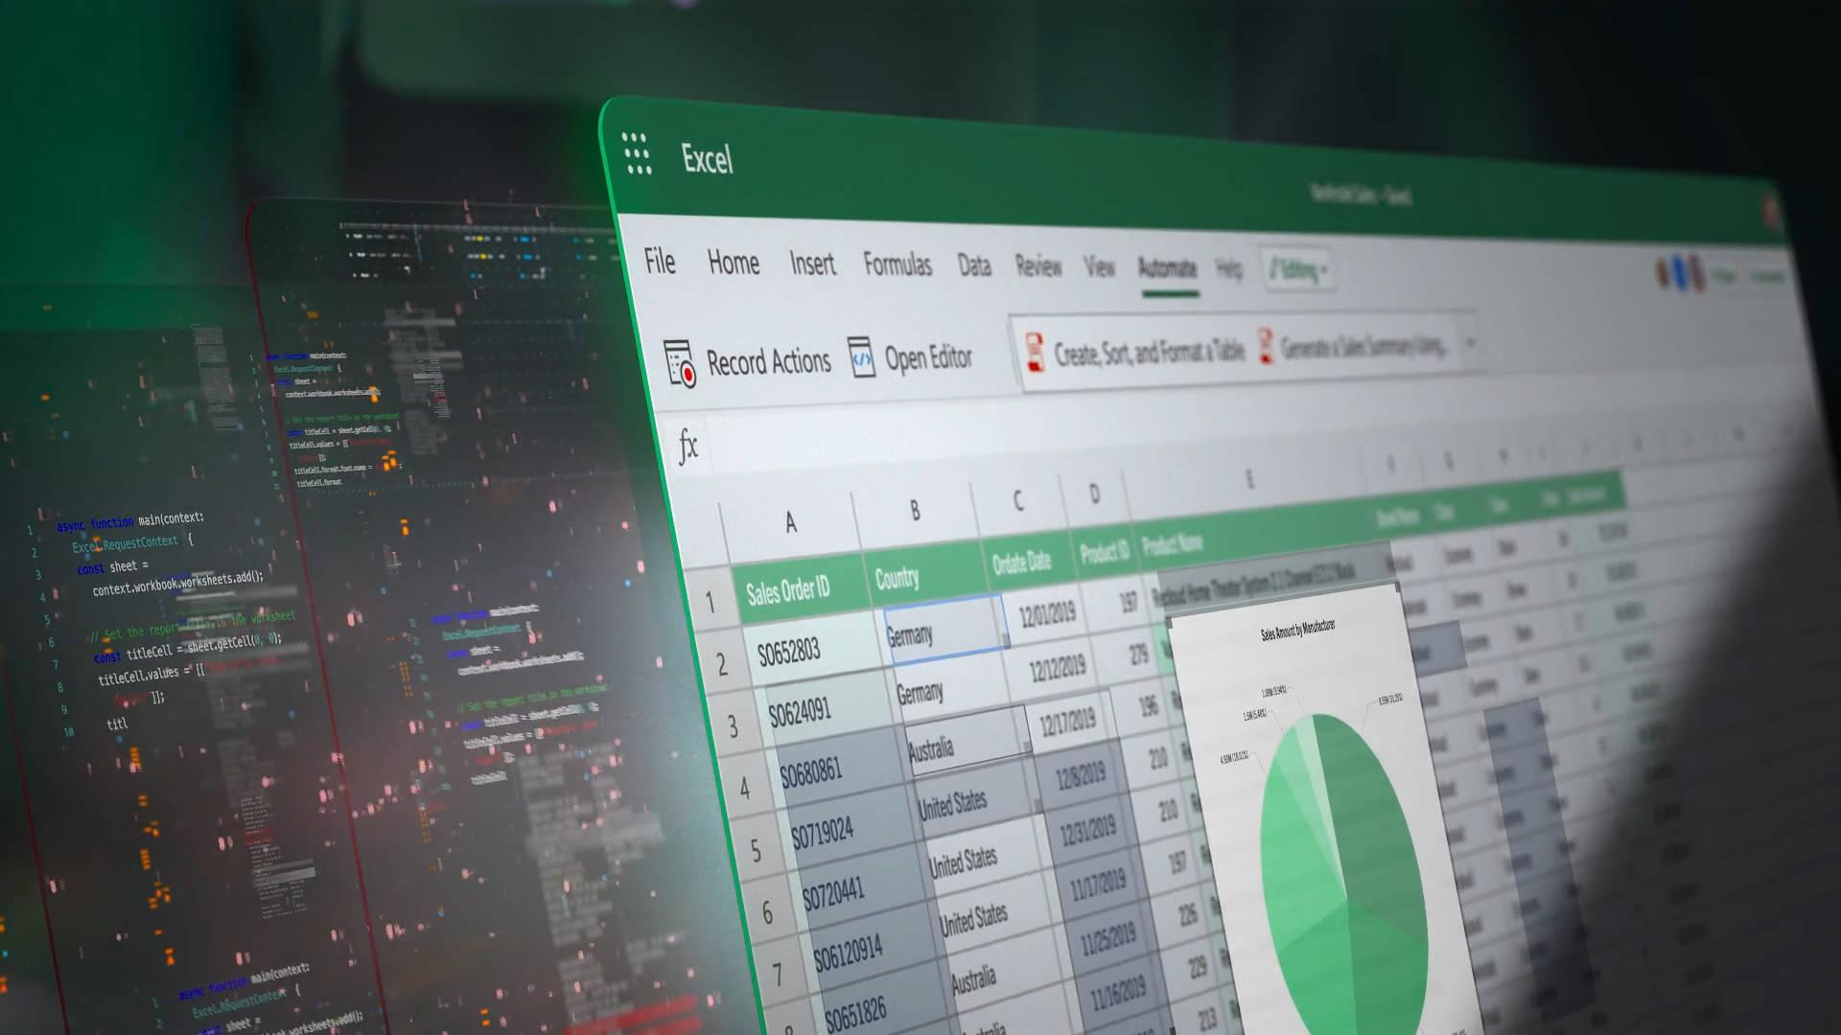
Conclusion: Data-Driven Logistics Management
Project Impact: Successfully transformed fragmented raw data into a structured, automated management system.
Operational Efficiency: The system provides real-time tracking of shipping performance and financial costs.
Scalability: The current database architecture is ready to handle larger datasets and more complex logistics operations.
Key Achievement: Bridged the gap between Excel’s analytical power and Access’s data integrity.
Empowering Logistics with Smart Data Solutions. Thank You
Ready for your Questions.

Slide 13
Project Impact: Successfully transformed fragmented raw data into a structured, automated management system.
Operational Efficiency: The system provides real-time tracking of shipping performance and financial costs.
Scalability: The current database architecture is ready to handle larger datasets and more complex logistics operations.
Key Achievement: Bridged the gap between Excel’s analytical power and Access’s data integrity.
Conclusion: Data-Driven Logistics Management
Empowering Logistics with Smart Data Solutions. Thank You
Ready for your Questions.

